Slide 1
ED Patients with Dizziness and Vertigo: Diagnosing a Serious Central Etiology

Slide 2
Edward P. Sloan, MD, MPH, FACEP

Slide 3
No financial conflicts. FERNE President and Board Chair.
Please go to our ferne.org website and our YouTube channel for more content related to the optimal care of the patient with dizziness and vertigo.
Follow us on social media for more real-time information on the care of all patients with neurological illnesses, injuries, and emergencies.

Slide 4
Professor Emeritus Department of Emergency Medicine University of Illinois at Chicago Chicago, IL
Edward P. Sloan, MD, MPH, FACEP

Slide 5
Medical Director Physician Assistant Studies Program Dominican University River Forest, IL

Slide 6
Medical Director New Rose Healthcare Management Emergency Department Roseland Community Hospital Chicago, IL

Slide 7
Thank you to: The Emergencies in Medicine Group. All of you.
March 1, 2023

Slide 8
Educational Objectives

Slide 9
Educational Objectives
(1) Enhance understanding of the definitions and pathophysiology of dizziness and vertigo.
(2) Understand what diagnoses are likely given the type of vertigo the dizzy patient describes.
(3) Know how to diagnose central causes using the dizzy/vertigo patient physical exam.

Slide 10
Educational Objectives
(4) Specify the exact history and physical exam findings that should be established and documented in the evaluation of ED patients with dizziness and vertigo [ATTEST, HINTS+ (+)].
(5) Review relevant publications that explain the role of the history, physical exam, neuroimaging, and new technologies in patients with dizziness and vertigo.

Slide 11
Dizziness and Vertigo Dictionary Definitions

Slide 12
Dizziness
dizzy
adjective
diz·​zy | \ ˈdi-zē \
FOOLISH, SILLY
Having a whirling sensation in the head with a tendency to fall
Mentally confused

Slide 13
Vertigo
noun
ver·​ti·​go ˈvər-ti-ˌgō
1.
a: a sensation of motion in which the individual or the individual's surroundings seem to whirl dizzily
b: a dizzy confused state of mind
Mentally confused

Slide 14
Vertigo
noun
ver·​ti·​go ˈvər-ti-ˌgō
2.
: disordered vertiginous movement as a symptom of disease in lower animals
also
: a disease (such as gid) causing this

Slide 15
Dizziness and Vertigo Consensus Definitions

Slide 16
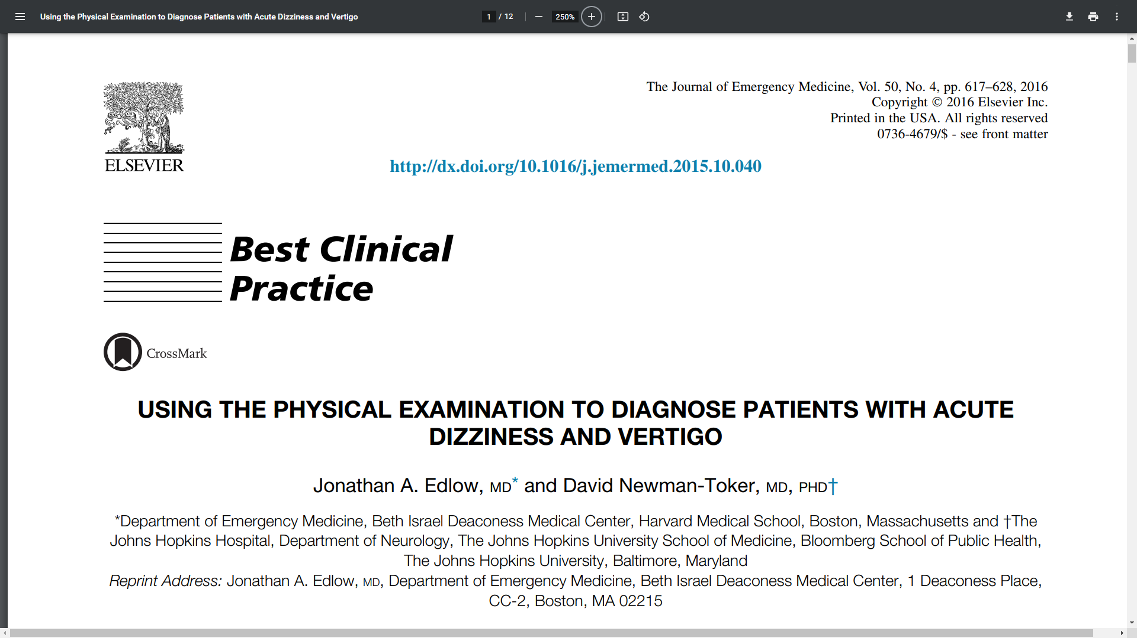
Dizziness and Vertigo Definitions
How have dizziness/vertigo terms been specified?
USING THE PHYSICAL EXAMINATION TO DIAGNOSE PATIENTS WITH ACUTE DIZZINESS AND VERTIGO
Jonathan A. Edlow, MD*
David Newman-Toker, MD, PHD†

Slide 17
Presyncope/ Near Syncope/ Faintness
How is presyncope defined by the consensus group?
Presyncope (also near syncope or faintness) is the sensation of impending loss of consciousness.
This sensation may or may not be followed by syncope.
39. Bisdorff A, Von Brevern M, Lempert T, Newman-Toker DE. Classification of vestibular symptoms: towards an international classification of vestibular disorders. J Vestib Res 2009;19:1–13. 40. Task Force for the Diagnosis and Management of Syncope; European Society of Cardiology (ESC); European Heart Rhythm Association (EHRA), et al. Guidelines for the diagnosis and management of syncope (version 2009). Eur Heart J 2009;30:2631–71.

Slide 18
Syncope
How is syncope defined by the consensus group?
Syncope (also faint) is:
transient loss of consciousness
due to transient global cerebral hypoperfusion
characterized by rapid onset, short duration, and spontaneous complete recovery.
Syncope usually leads to loss of postural control, falling.
39. Bisdorff A, Von Brevern M, Lempert T, Newman-Toker DE. Classification of vestibular symptoms: towards an international classification of vestibular disorders. J Vestib Res 2009;19:1–13. 40. Task Force for the Diagnosis and Management of Syncope; European Society of Cardiology (ESC); European Heart Rhythm Association (EHRA), et al. Guidelines for the diagnosis and management of syncope (version 2009). Eur Heart J 2009;30:2631–71.

Slide 19
Unsteadiness
How is unsteadiness defined by the consensus group?
Unsteadiness (formerly known as disequilibrium) is:
the feeling of being unstable
while seated, standing, or walking
without a particular directional preference.
Cerebral ischemia?
39. Bisdorff A, Von Brevern M, Lempert T, Newman-Toker DE. Classification of vestibular symptoms: towards an international classification of vestibular disorders. J Vestib Res 2009;19:1–13. 40. Task Force for the Diagnosis and Management of Syncope; European Society of Cardiology (ESC); European Heart Rhythm Association (EHRA), et al. Guidelines for the diagnosis and management of syncope (version 2009). Eur Heart J 2009;30:2631–71.

Slide 20
Directional Pulsion
How is directional pulsion defined by the consensus group?
Directional pulsion is:
the feeling of being unstable
tendency to veer or fall in a particular direction
while seated, standing, or walking.
(Unsteady in a direction).
Cerebral ischemia?
39. Bisdorff A, Von Brevern M, Lempert T, Newman-Toker DE. Classification of vestibular symptoms: towards an international classification of vestibular disorders. J Vestib Res 2009;19:1–13. 40. Task Force for the Diagnosis and Management of Syncope; European Society of Cardiology (ESC); European Heart Rhythm Association (EHRA), et al. Guidelines for the diagnosis and management of syncope (version 2009). Eur Heart J 2009;30:2631–71.

Slide 21
Directional Pulsion
Skiing in a whiteout.
When stopping, eyes continue to move.
Body moves in an unusual way.
Skiing at the top of Snowbird in 2019!!

Slide 22
Vertigo
How is vertigo defined by the consensus group?
Vertigo is the:
sensation of self-motion (of head/body)
when no self-motion is occurring or
the sensation of distorted self-motion during an otherwise normal head movement.
(Motion noted.)
39. Bisdorff A, Von Brevern M, Lempert T, Newman-Toker DE. Classification of vestibular symptoms: towards an international classification of vestibular disorders. J Vestib Res 2009;19:1–13. 40. Task Force for the Diagnosis and Management of Syncope; European Society of Cardiology (ESC); European Heart Rhythm Association (EHRA), et al. Guidelines for the diagnosis and management of syncope (version 2009). Eur Heart J 2009;30:2631–71.

Slide 23
Vertigo
How is vertigo defined by the consensus group?
Vertigo includes:
a false sense of rotation (e.g., spinning, rocking),
linear motion (e.g., feeling of falling downward, as in an elevator),
or static tilt relative to gravity.
(Rotation, linear motion, or tilt.)
39. Bisdorff A, Von Brevern M, Lempert T, Newman-Toker DE. Classification of vestibular symptoms: towards an international classification of vestibular disorders. J Vestib Res 2009;19:1–13. 40. Task Force for the Diagnosis and Management of Syncope; European Society of Cardiology (ESC); European Heart Rhythm Association (EHRA), et al. Guidelines for the diagnosis and management of syncope (version 2009). Eur Heart J 2009;30:2631–71.

Slide 24
Dizziness
How is dizziness defined by the consensus group?
Dizziness is the:
sensation of
disturbed or impaired spatial orientation
without a false or distorted sense of motion.
This includes sensations sometimes referred to as:
giddiness, lightheadedness,
or non-specific dizziness,
but does not include vertigo.
(No motion.)
39. Bisdorff A, Von Brevern M, Lempert T, Newman-Toker DE. Classification of vestibular symptoms: towards an international classification of vestibular disorders. J Vestib Res 2009;19:1–13. 40. Task Force for the Diagnosis and Management of Syncope; European Society of Cardiology (ESC); European Heart Rhythm Association (EHRA), et al. Guidelines for the diagnosis and management of syncope (version 2009). Eur Heart J 2009;30:2631–71.

Slide 25
Dizziness and Vertigo Clinical History Questions

Slide 26
Dizzy/Vertigo Background Clinical Q
Syncope / Near syncope
Did you lose consciousness (pass out) and woke up in a chair or on the ground?
Did you feel faint and almost pass out, like when people see blood?
Unsteadiness / Directional Pulsion
Did you feel unstable on your feet?
Did you feel as if you were veering to the side?*** (Acute Cerebellar Ischemia)

Slide 27
Dizzy/Vertigo Clinical Questions
Vertigo
Did you feel like you were moving even when still?
Did you feel a spinning, rocking or tilting motion?
Did you have the feeling of falling downward, as in an elevator?
Did this occur with you moving your head?
Did this occur while at rest and without motion?
Have you had this type of episode before?
Are you having these vertigo symptoms now?

Slide 28
Dizzy/Vertigo Clinical Questions
Dizziness
Did you feel a sensation of disturbed or impaired spatial orientation (world seems visually odd)?
Did you feel giddy, lightheaded, or dizzy?

Slide 29
Dizzy/Vertigo Clinical Questions
Past History
Have you ever been diagnosed with syncope, near syncope, vertigo, or dizziness in the past?
Have you ever been treated for low blood count, low blood pressure, low heart rate, or low blood sugar?

Slide 30
Clinical Questions Take Home Points
Questions Order
Go in “reverse” order
Start with syncope and near syncope
Consider unsteadiness with standing/gait
Probe vertigo symptoms (type/timing/triggers)
Discuss feeling dizzy last
Review systemic causes of dizzy/weakness symptoms

Slide 31
Clinical Diagnoses Take Home Points
Diagnoses
Systemic diagnoses can be determined efficiently.
Syncope/near syncope? Diagnosis established.
Unsteady with standing/gait? Cerebellar ischemia*?
Vertigo symptoms?
Current, continuous? Acute Vestibular Syndrome (AVS)*
Spontaneous episodic vertigo (sEVS)*
Triggered episodic vertigo (tEVS)
Non-specific dizziness is the diagnosis of exclusion.

Slide 32
Relevant Disease States That Can Cause Dizziness/Vertigo

Slide 33
Dizziness/Vertigo Diagnoses
In Alphabetical Order:
Alternobaric Vertigo (Ruptured TM)
Benign Paroxysmal Positional Vertigo (BPPV)
Brainstem Infraction*
Central Vertigo*
Cerebellar Dysfunction / Ischemia / Infarct*
Anterior Ischemic Stroke / TIA*
Labyrinthitis
Meniere Disease

Slide 34
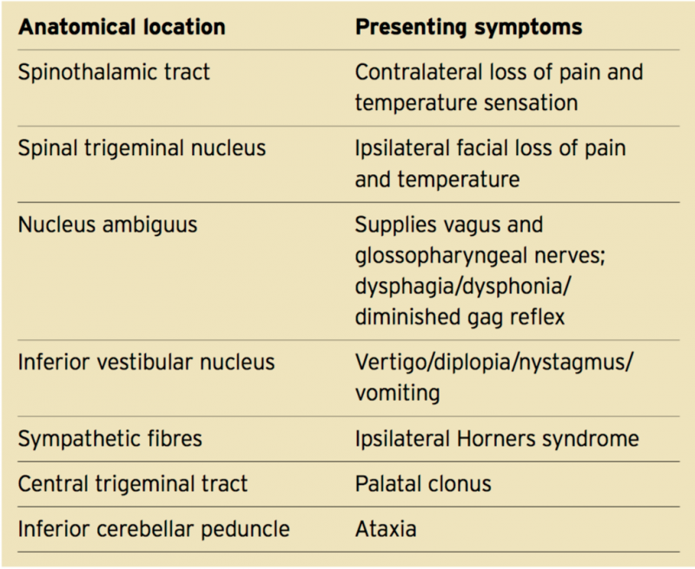
Dizziness/Vertigo Diagnoses
In Alphabetical Order (Con’t)
Migraine-Associated Vertigo*
Motion Sickness
Peripheral Vertigo
Persistent Postural-Perceptual Dizziness
Vertebrobasilar Insufficiency / Stroke*
Vestibular Neuronitis
Wallenberg Syndrome*
Wallenberg syndrome is a neurological condition that is also referred to as lateral medullary syndrome or posterior inferior cerebellar artery syndrome.

Slide 35
Diagnoses Related to Three Vertigo Types

Slide 36
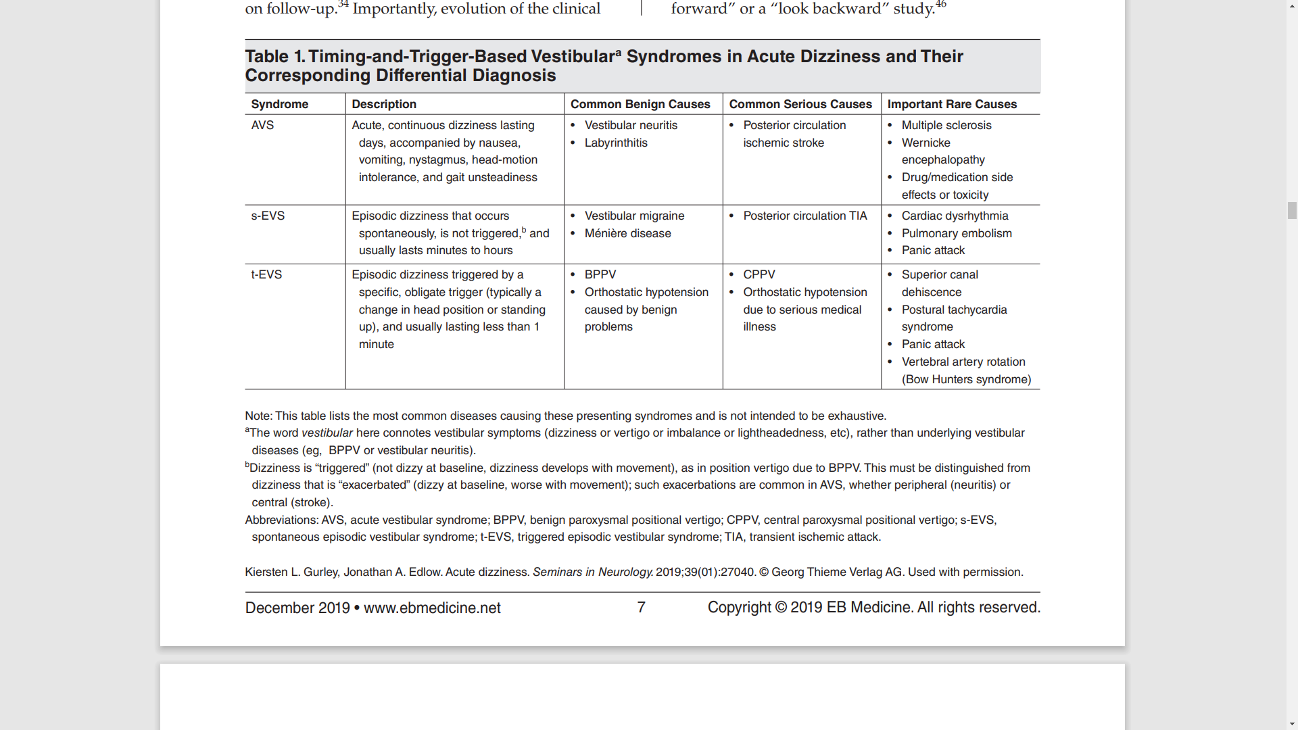
Vertigo Types and Likely Diagnoses
What diagnoses are to be considered based on the vertigo timing, triggers, and current Sx?

Slide 38
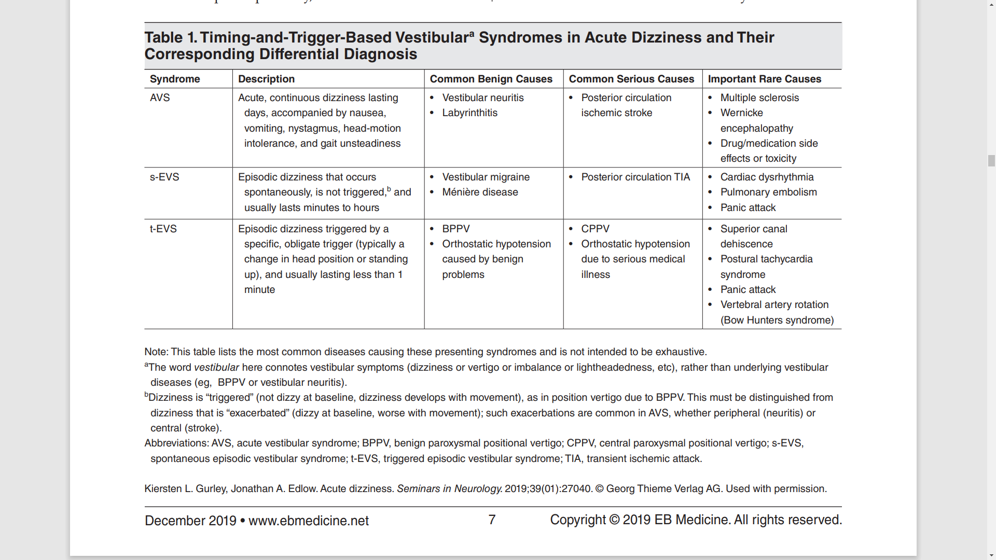
Vertigo Timing, Triggers, Diagnoses: 6 Benign and 4 Serious Causes

Slide 39
Dizziness Etiologies, Normal Functioning and Diagnoses

Slide 40
Dizziness / Vertigo Pathologies
Systemic (fluids, electrolytes, Hb, BP)
Peripheral (Vestibular dysfunction)
Central (CNS ischemia, event, lesion)

Slide 41
Normal Vestibular Anatomy / Mechanisms, At-risk Posterior Circulation Areas

Slide 43
Peripheral Vestibular Organs
Figure 2, Page 4 of monograph
Utricle, saccule
Sense vertical and horizontal acceleration
Three semi-circular canals
Sense movement in three directions
Vestibular nerve
Carries input to the brain from periphery

Slide 45
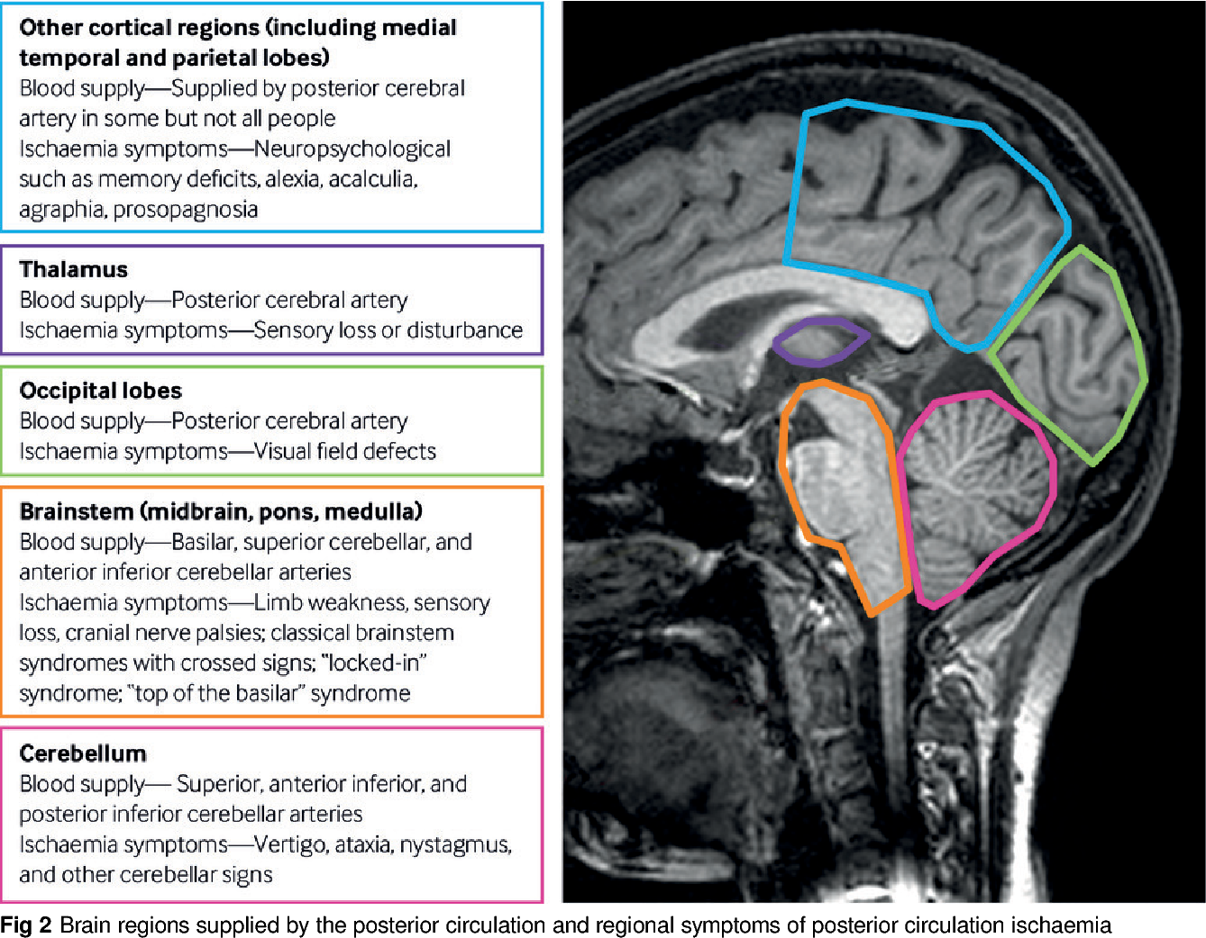
Posterior Circulation Stroke
Posterior Circle of Willis blood flow disruption to brain and brain stem.

Slide 46
Dizziness / Vertigo Case Studies

Slide 47
Dizziness Case: Lightheaded 70 yo
70-year-old female
“Lightheadedness” for five days
Worse with getting out of bed
The dizziness wakes her out of sleep
HTN, cholesterol meds
VS OK, normal neuro exam, no nystagmus
Should a CT be ordered? Why?

Slide 48
Dizziness Case: Syncopal 58 yo
58-year-old male DM, NV x 3
Syncope reported, but was such bad vertigo he had to lower himself to the ground
Began 3 hours previously, suddenly
Nystagmus to R, especially with gaze R
HIT test +, skew neg, mild unsteady OK gait
Call the stroke team?

Slide 49
Dizziness Case: 44 yo Dizzy Male
Sign out. Just check the CT…
44-year-old male, Hx HTN, DM
Six hours continuous dizziness
Unsteadiness. “feeling like I am drunk…”
Normal VS
L beating nystagmus with gaze
Improved with benzodiazepine Rx
“If CT is OK, home with meclizine…”

Slide 50
If Motion Symptoms, Central and Peripheral Diagnoses Related to Three Vertigo Types

Slide 52
Vertigo Types and Likely Diagnoses
What diagnoses are to be considered based on the vertigo timing, triggers, and current Sx?

Slide 53
Vertigo Timing, Triggers, Diagnoses: 6 Benign and 4 Serious Causes

Slide 54
Clinical Questions Take Home Points
Diagnoses
Syncope/near syncope? Diagnosis established.
Unsteady with standing/gait? Cerebellar ischemia?
Vertigo symptoms? Three types of vertigo:
Current, continuous? Acute Vestibular Syndrome (AVS).
Spontaneous episodic vertigo (sEVS)
Triggered episodic vertigo (tEVS)
Non-specific dizziness is the diagnosis of exclusion.

Slide 55
Patient Clinical Evaluation: The ATTEST System

Slide 56
Dizziness H & P: ATTEST
Associated symptoms
Timing
Triggers
Examination Signs
(Confirmatory) Testing

Slide 57
ATTEST Clinical Pathway

Slide 58
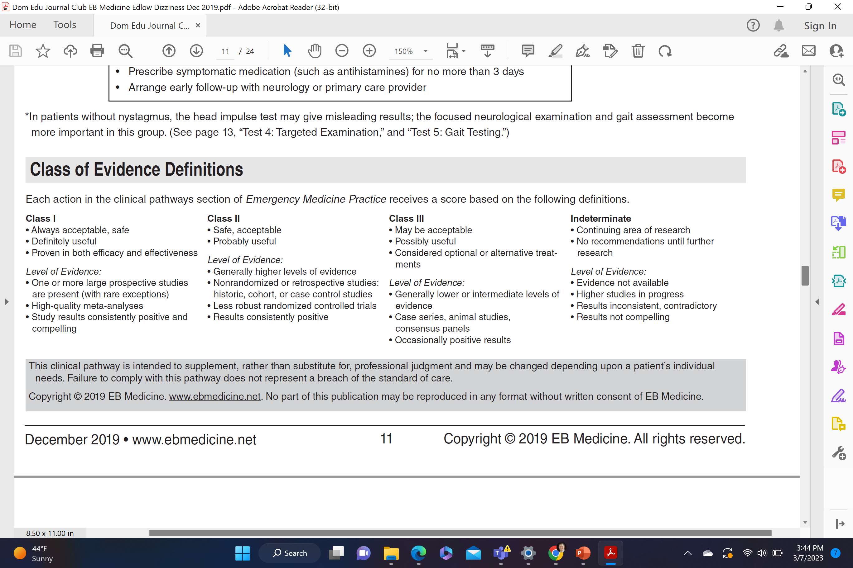
ATTEST Clinical Evidence

Slide 59
ATTEST Part 1: General Medical Cause?

Slide 60
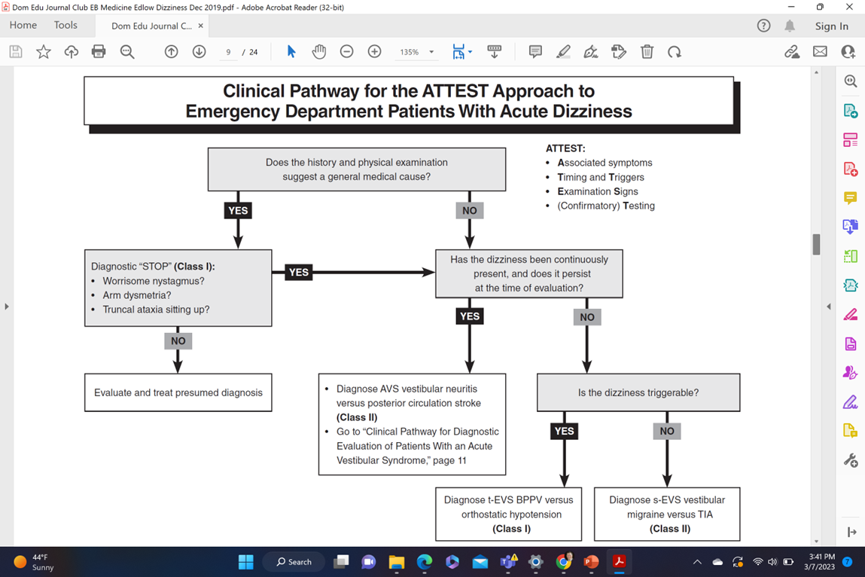

Slide 62
General Medical Cause
Likely medical cause: Yes.
No worrisome signs: Correct.
No worrisome nystagmus.
Patient can sit and stand.
No motor abnormalities.
No arm dysmetria.
No vision, speech, swallow, sensory* changes
Treat the medical cause, CT +/-

Slide 63
ATTEST Part 2: Acute Vestibular Syndrome

Slide 66
Acute Vestibular Syndrome
Likely medical cause: No. Or…
Possible worrisome nystagmus: Yes.
Continuous & present vertigo: Yes.
Dx: Acute Vestibular Syndrome (AVS)
Vestibular Neuritis or Labyrinthitis (Peripheral etiology)
Posterior Circulation Stroke***

Slide 67
ATTEST Part 3: Episodic Vertigo: Spontaneous or Triggered

Slide 68
Spontaneous, Episodic Vestibular Syndrome (s-EVS)

Slide 72
Spontaneous, Episodic Vestibular Syndrome
Likely medical cause: No. Or…
Possible worrisome nystagmus: Yes.
Continuous & present vertigo: No.
Triggered? Head Mvmt, Standing: No
Dx: Spontaneous, Episodic Vestibular Syndrome (s-EVS)
Meniere Dx, Vestibular migraine
Cardiac dysrhythmia
Posterior Circulation TIA***

Slide 73
ATTEST Part 3: Episodic Vertigo: Spontaneous or Triggered

Slide 74
Triggered, Episodic Vestibular Syndrome (t-EVS)

Slide 76
Triggered, Episodic Vestibular Syndrome
Likely medical cause: No. Or…
Possible worrisome nystagmus: Yes.
Continuous & present vertigo: No.
Triggered? Head Mvmt, Standing: Yes
Dx: Triggered, Episodic Vestibular Syndrome (t-EVS)
BPPV (Peripheral)
Orthostatic Hypotension (Systemic)
Posterior fossa tumor (Central)

Slide 77
Dizziness / Vertigo Bedside Physical Exam

Slide 79
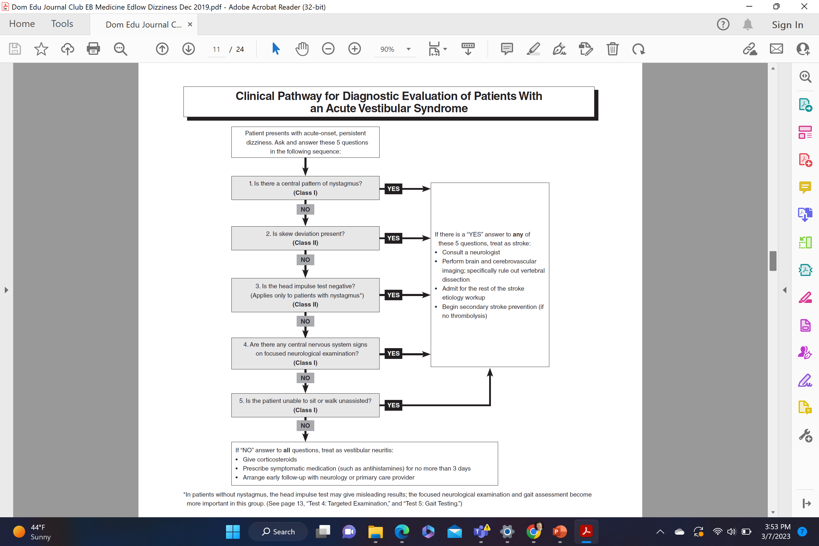

Slide 80
Vertigo Stroke/TIA Findings
For patients with AVS and s-EVS***
Five tests are performed with these central Sx:
Nystagmus exam
No unilateral HIT exam
Vertical skew deviation
Stroke exam signs including new hearing loss
Ataxia
If any of these 5 findings are found, posterior circulation stroke or ischemia (TIA) are likely.

Slide 81
Vertigo Stroke/TIA Findings
Central pattern nystagmus
Negative, no unilateral, correct saccade on HIT
Skew deviation with vertical correction
CNS signs on neuro exam (hearing loss)
Patient is unable to sit or walk unassisted
Any one of these suggest posterior circulation stroke/ischemia or TIA.
Red light!

Slide 85
Vertigo Patient Bedside Physical Exam: Peripheral vs Central Nystagmus (in AVS)

Slide 86
Nystagmus in AVS: Three Caveats
1. Nystagmus exam in this case is related to patients with acute vestibular syndrome (AVS). The nystagmus exam in patients in other clinical settings will vary such that these central vs peripheral tenets may not apply.
2. Nystagmus is discussed first in the HINTS exam because the Horizontal Impulse Test exam results only apply in patients with nystagmus.
3. If a patient DOES NOT have nystagmus in the setting of profound vertigo and ataxia, a central etiology should be suspected regardless of the HINTS exam.

Slide 87
Nystagmus in AVS: Peripheral vs Central
Peripheral etiology:
Horizontal nystagmus commonly present
One-directional horizontal movement (fast correction in one direction, other side with illness)
Central etiology:
Horizontal nystagmus absent
Vertical or torsional (rotational) nystagmus
Bidirectional horizontal fast nystagmus movement
(Bidirectional fast correction due to central disease)
(Both vestibular system sides not likely sick)

Slide 88
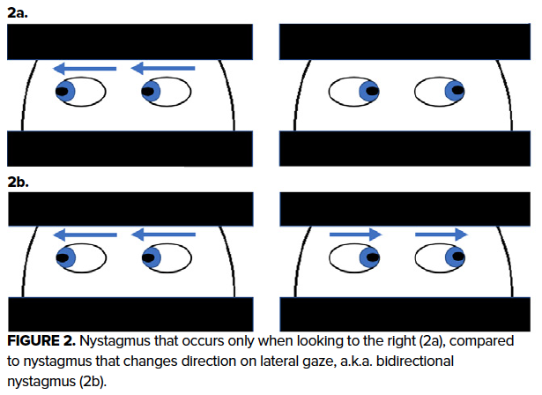
Central Etiology Nystagmus in AVS
Central etiology:
Horizonal nystagmus absent
Vertical or torsional (rotational) nystagmus
Horizontal fast nystagmus correction in both directions c/w central disease (Please see in bottom eyes 2b below.)
(Eyes go fast in both directions with change in gaze direction.)
https://www.emra.org/emresident/article/hints-exam/

Slide 89
Nystagmus in AVS Patients
Central:
Vertical or torsional (rotary) nystagmus.
Bidirectional nystagmus.
No nystagmus noted.
Peripheral:
Unidirectional horizontal fast nystagmus.
(One vestibular system is sick.)

Slide 90
Vertigo Patient Bedside Physical Exam: Peripheral vs Central Head Impulse Test

Slide 91
Head Impulse Test
Only verified useful in patients with nystagmus*
Looking for asymmetry in vestibular response
Hold head 15⁰ each side, quick move to center
Peripheral: Unilateral correcting saccade
There is a unilateral fast correcting saccade to center seen with eye mvmt (vestibular problem)
Central etiology: Bilaterally no center correction is seen
No unilateral correcting saccade, eyes remain centered
No peripheral vestibular problem
https://www.dizziness-and-balance.com/practice/head-impulse.html

Slide 92
Head Impulse Test
Figure 5, page 12 of monograph
Shows how eyes follow rotation to the diseased side with correcting saccade to the center
A unilateral compensatory saccade suggests peripheral vestibular etiology of dizziness
If there is no compensatory saccade bilaterally, and eyes remain fixed centrally, the vestibular system is working normally (so think central)
https://www.sralab.org/rehabilitation-measures/head-impulse-test-head-thrust-test

Slide 93
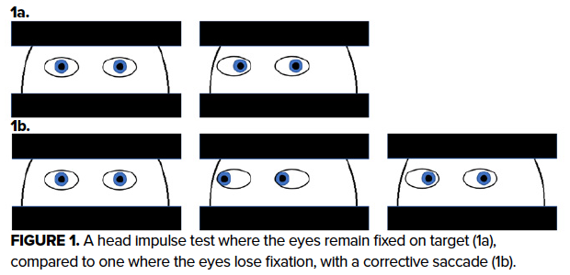
Central Head Impulse Test
If no compensatory saccade is seen on both sides, and
Eyes remain fixed centrally… Vestibular system normal.
(Therefore, think central. Please see 1a below.)
Central etiology: No unilateral saccade with head movement to each side.
Eyes remain straight forward bilaterally.
Neither vestibular system side is sick.
Take a HINT on Central Vertigo in the Emergency Department EMRA

Slide 95
Peripheral etiology: Unilateral saccade is good.
A saccade on one side is good because it means one vestibular system side is sick. (Peripheral.)
Central etiology: No unilateral saccade
because neither vestibular system side is sick.
No saccade bilaterally, think central etiology.

Slide 96
Head Impulse Test Language
Only performed in patients with AVS, nystagmus
(Normal pts: no correcting fast saccade)
Central Dx pts: no correcting fast saccade
Unilateral corrective saccade to center with turn suggests vestibular etiology (one diseased side)
Unilateral eye saccade is correct, (good) when vestibular dx is the likely etiology of dizziness
No saccade in neither direction is worrisome, not correct, in dizzy AVS patients, no vestibular system is sick. Must consider a central etiology.

Slide 97
Head Impulse Test
Central:
No saccade means normal vestibular function. Eyes stay midline bilaterally.
If there is no saccade bilaterally, then both vestibular systems work. (Not sick.)
The vertigo could be a central etiology!
Peripheral:
One side has a saccade because one peripheral vestibular system is ill.

Slide 98
Vertigo Patient Bedside Physical Exam: Peripheral vs Central Test of Skew

Slide 99
Test of Skew
Cover, uncover one eye at a time alternately
Peripheral etiology: No vertical skew deviation
No vertical correction as eye is uncovered
Central etiology: Positive skew deviation
Vertical correction as eye is uncovered to get both pupils to be aligned on vertical axis
Similar to vertical nystagmus
Bad finding in AVS patients

Slide 100
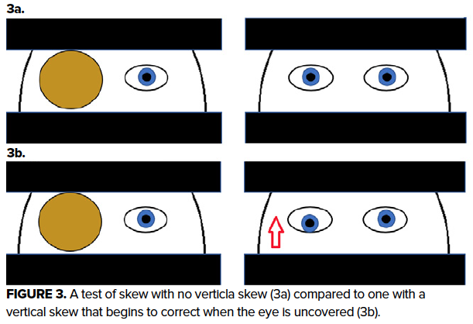
Positive (Central) Test of Skew
Cover, uncover alternating eyes, one eye at a time covered.
Central etiology: Positive skew deviation.
Vertical correction as eye is uncovered to get both pupils to be aligned on vertical axis (See arrow in R eye 3b below.)
One eye moves vertically to correct pupils.
Take a HINT on Central Vertigo in the Emergency Department EMRA

Slide 101
Test of Skew
Central:
Pupils are misaligned vertically.
When one eye is uncovered, there is a vertical correction for pupils to align.
Peripheral:
Pupils align vertically when either eye is uncovered.
No vertical misalignment or correction.

Slide 102
Vertigo Patient Bedside Physical Exam: Peripheral vs Central Neurological Exam

Slide 103
Neurological Exam Findings
Peripheral etiology: No findings
No cranial nerve, brainstem, or cerebellar findings
Central etiology:
Limb ataxia, dysarthria, hearing loss*
Pain, temperature sensory loss**
Diplopia, ptosis, anisocoria, dim vision

Slide 104
Neurological Exam
Central Findings:
CN: Ptosis, unequal pupils, hearing loss
Brainstem (Posterior Circulation)
> Pain/temp sensory loss
> Dim vision, dysarthria
Cerebellar: Limb ataxia
Peripheral:
No CN, brainstem, or cerebellar findings.

Slide 105
Vertigo Patient Bedside Physical Exam: Peripheral vs Central Truncal Ataxia & Gait

Slide 106
Truncal Ataxia and Ataxic Gait Test
Peripheral etiology: No findings
Able to sit without holding on, able to walk
Central etiology:
Unable to sit without holding on / leaning
Unable to walk unassisted
Truncal ataxia or ataxic gait

Slide 107
Truncal Ataxia & Gait
Central Findings:
Truncal Ataxia: Leaning when sitting
Ataxia: Wide-based standing/walking
Peripheral:
Patient able to sit, stand up, and walk

Slide 108
Vertigo Patient Bedside Physical Exam: Peripheral vs Central Negative Big Five HINTS+ (+)

Slide 109
HINTS+ (+) Central Vertigo Signs
Vertical, torsional, or bilateral fast nystagmus
Normal HIT bilaterally, eyes remain central, no saccade
Vertical SKEW correction is seen
Central neurological findings:
Limb ataxia, dysarthria, [hearing loss (HINTS +)]
Pain, temperature sensory loss**
Diplopia, ptosis, anisocoria, dim vision
(Truncal ataxia or ataxic gait)
(Extremity weakness, facial asymmetry, aphasia, AMS)

Slide 110
HINTS+ (+) is Physical Exam Testing
HINTS+ (+):
Nystagmus (Bilat fast, vert, rotation bad)
Head Impulse (No unilateral saccade bad)
Test of Skew (Vertical skew bad)
+ Hearing loss (New hearing loss bad)
(+) Truncal ataxia and gait (Both bad)
(+) Anterior stroke signs (Any are bad)
If any of these are found: Red Light!

Slide 111
Negative Big 5: HINTS+ (+)
All Clear. Green light to go:
One side has a saccade because one peripheral vestibular system is ill unilaterally.
Unidirectional horizontal nystagmus only.
Pupils are aligned vertically when testing skew.
No posterior neuro Sxs (hearing loss is HINTS +).
(Patient able to sit, stand up, and walk.)
(No anterior stroke Sx: weak, face, speech, AMS.)
HI N TS + (+)

Slide 112
Negative Big 5: HINTS+ (+)
All Clear. Green light to go:
One side has a saccade because one peripheral vestibular system is ill unilaterally.
Unidirectional horizontal nystagmus only.
Pupils are aligned vertically when testing skew.
No posterior neuro Sxs (hearing loss is HINTS +).
(Patient able to sit, stand up, and walk.)
(No anterior stroke Sx: weak, face, speech, AMS.)
HI N TS + (+)

Slide 113
HINTS+ (+) is Physical Exam Testing
HINTS+ (+):
Nystagmus (Bilat fast, vert, rotation bad)
Head Impulse (No unilateral saccade bad)
Test of Skew (Vertical skew bad)
+ Hearing loss (New hearing loss bad)
(+) Truncal ataxia and gait (Both bad)
(+) Anterior stroke signs (Any are bad)
If any of these are found: Red Light!

Slide 114
HINTS+ (+) and Peripheral Etiology
To make Vestibular Neuritis Dx in AVS:
1. need unilateral fast nystagmus and
2. need unilateral saccade on Head Impulse test.
Head impulse must show unilateral correction saccade in order for the diagnosis to be peripheral vestibular neuritis.
One vestibular system must be malfunctioning and the HI test must show unilateral saccade.
No unilateral saccade is bad: it means central.

Slide 115
Dizziness / Vertigo, HINTS Testing & the Medical Literature: FERNE National Journal Club

Slide 116
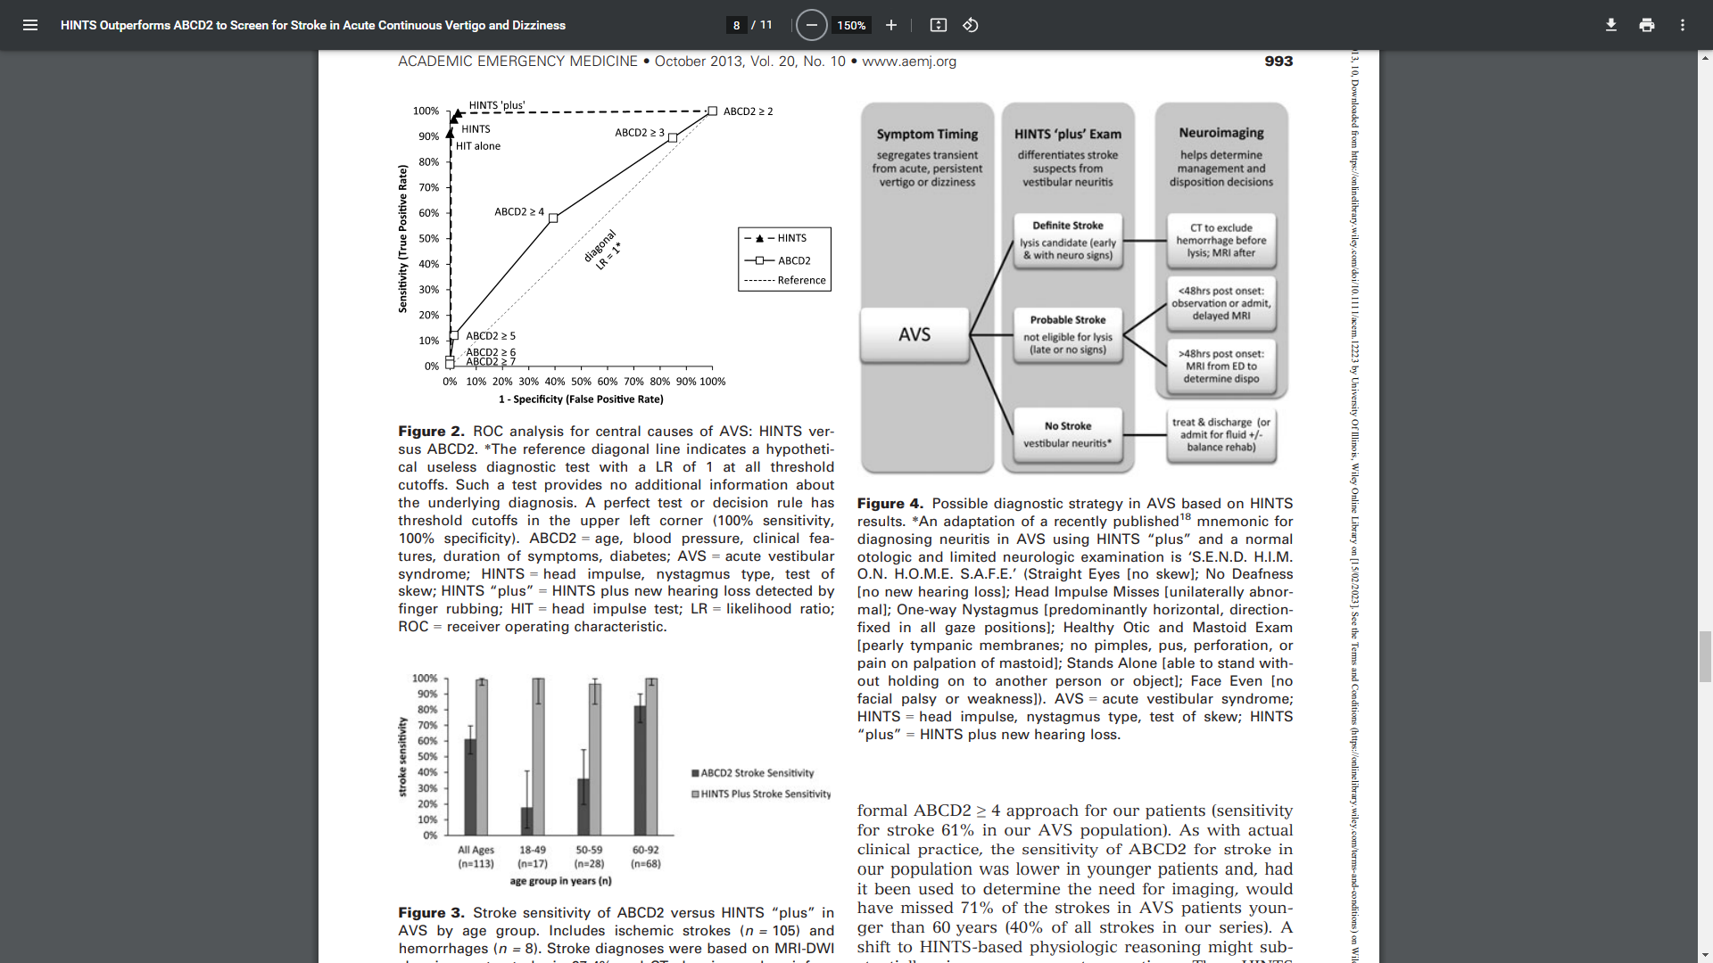
HINTS vs. ABCD2 for Stroke / TIA
HINTS plus new hearing loss = highest AUC.
HINTS +
AUC is all signal, no noise!
(Yellow curve.)

Slide 117
HINTS +, Imaging, and Disposition
HINTS +, SEND HIM ON HOME SAFE MNEUMONIC.
‘S.E.N.D. H.I.M. O.N. H.O.M.E. S.A.F.E.’
Straight Eyes [no skew];
No Deafness [no new hearing loss];
Head Impulse Misses [unilaterally abnormal];
One-way Nystagmus [predominantly horizontal, direction fixed in all gaze positions];
Healthy Otic and Mastoid Exam [pearly tympanic membranes; no pimples, pus, perforation, or pain on palpation of mastoid];
Stands Alone [able to stand without holding on to another person or object];
Face Even [no facial palsy or weakness].

Slide 118
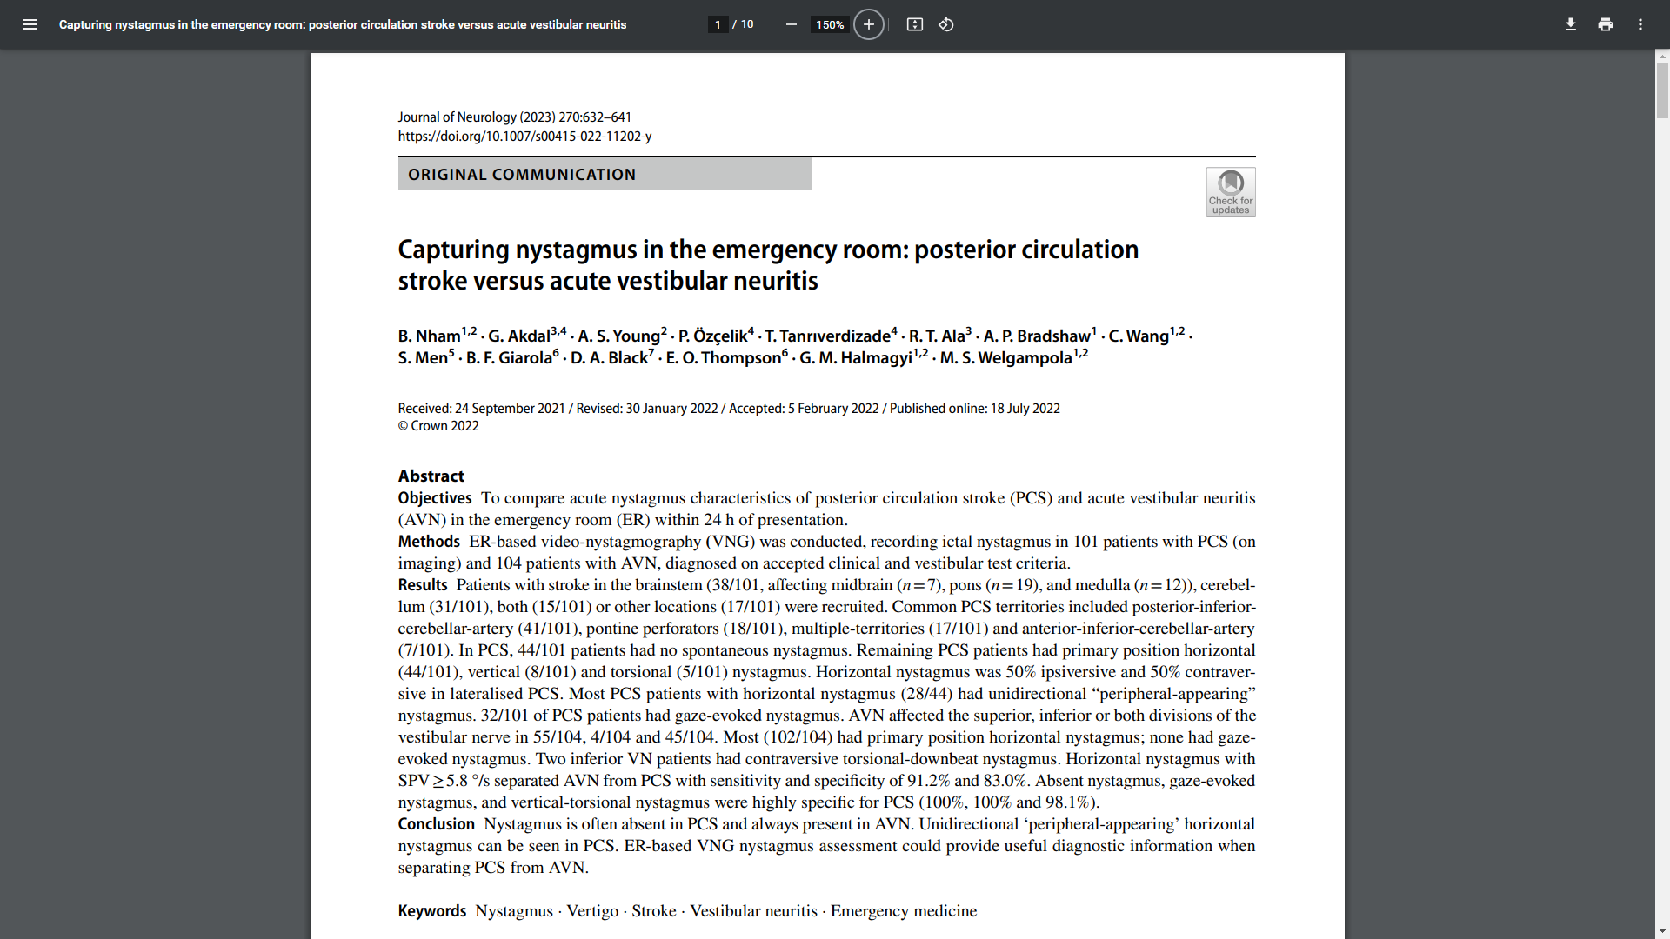
Nystagmus and Posterior Stroke
Nystagmus can’t be used alone for stroke Dx.
Nystagmus is often absent in central etiology vertigo.
“Peripheral appearing” nystagmus can be seen in central etiology vertigo.

Slide 119
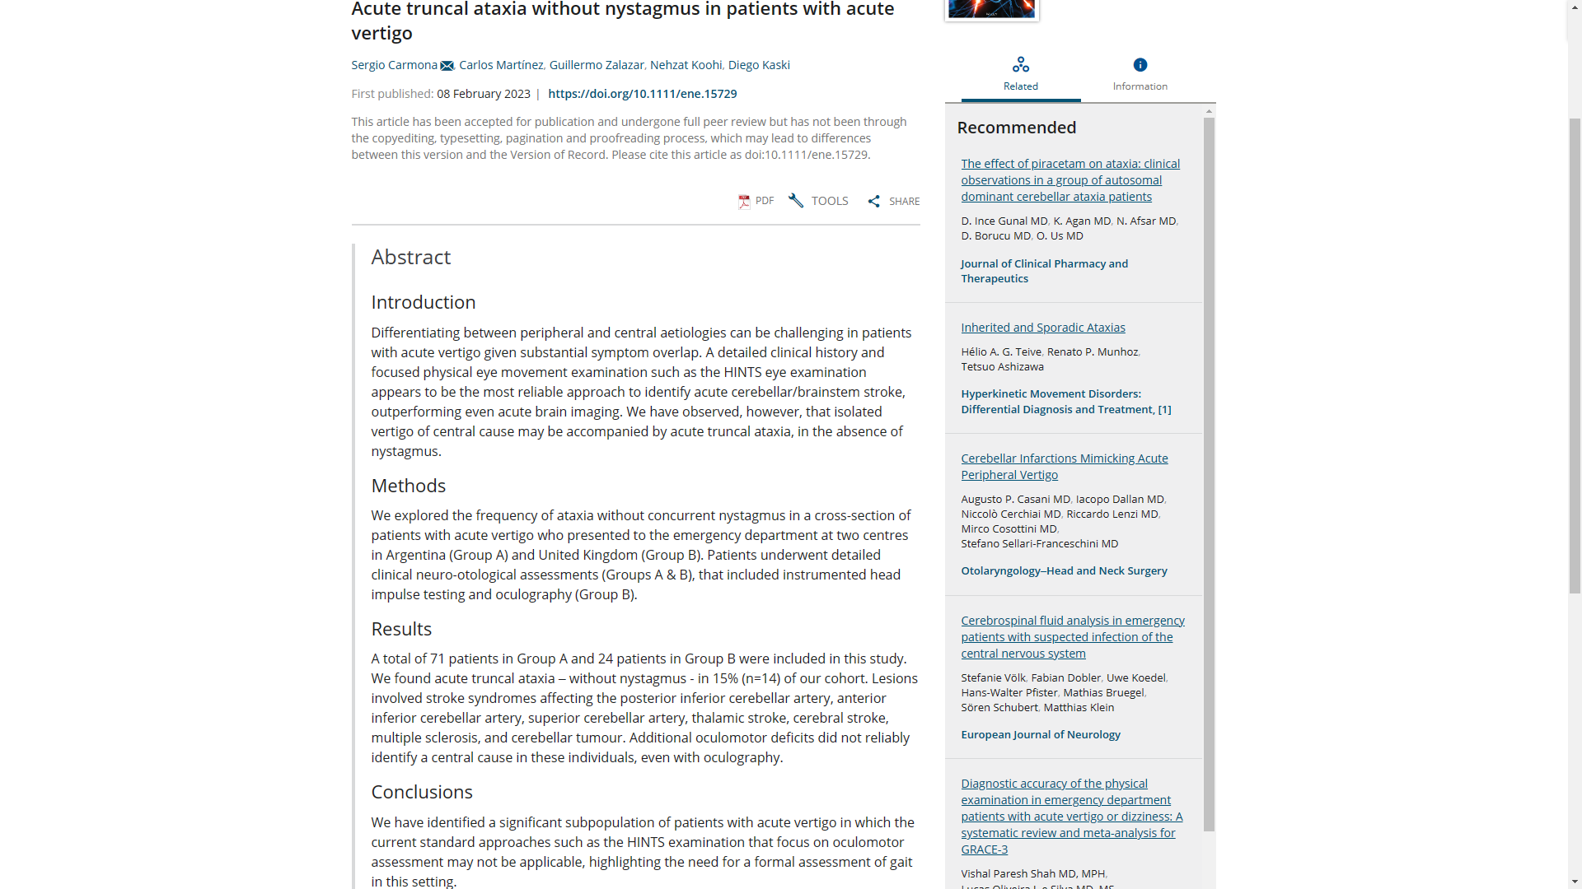
Acute Truncal Ataxia and Nystagmus
HINTS plus an exam for truncal ataxia is key.
Isolated acute truncal ataxia of central etiology may occur in the absence of nystagmus.
95 acute vertigo patients.
15% of patients had no nystagmus but did have ataxia.
Stroke syndromes of post inf cerebellar art (PICA), ant inf cerebellar art (AICA), and sup cerebellar art (SCA).
Thalamic and cerebral strokes seen.
Multiple sclerosis (MS) noted.
Cerebellar tumor noted.
Oculomotor exam did not detect all central lesions.
HINTS exam must be supplemented by neuro exam to include search for truncal ataxia.

Slide 120
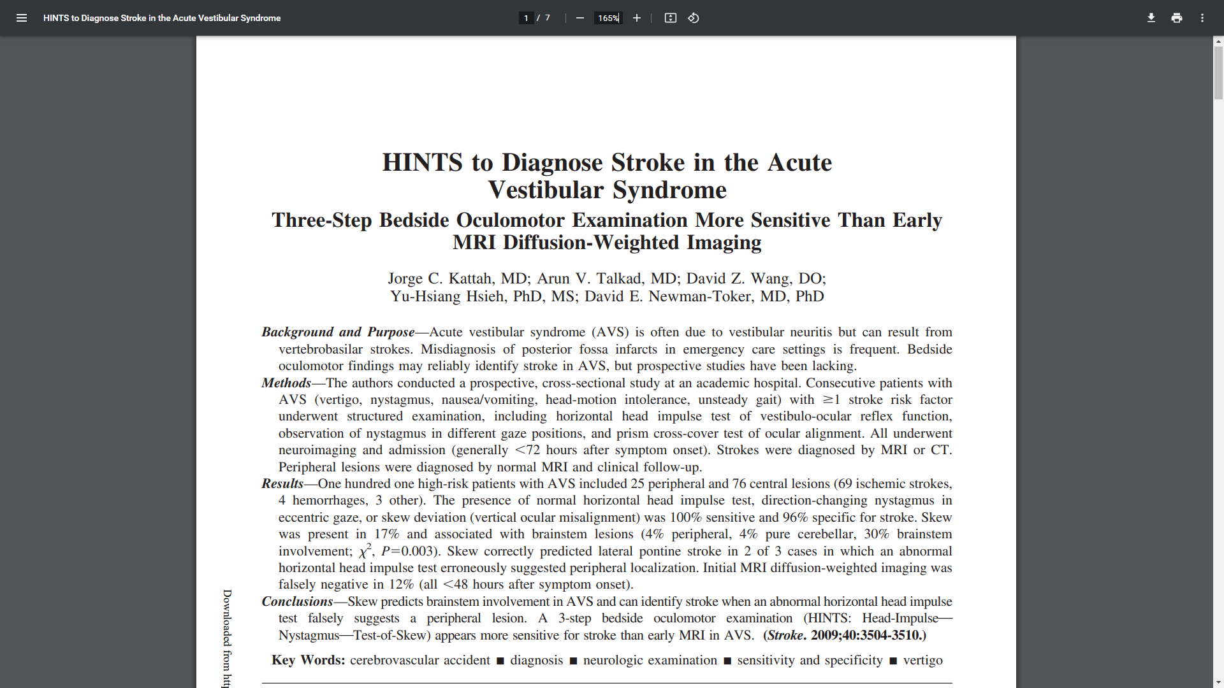
HINTS Testing vs. MRI
HINTS may detect early stroke before MR DWI changes.
101 AVS patients with HINTS testing.
75% central,
25% peripheral.
HINTS testing 100% sensitive,
96% specific for stroke.
Skew in 17% pts,
1/3 were lesions in brainstem.
MR DWI at <48 hrs) was false neg in 12% of pts.
Skew predicts brainstem in AVS patients.
Skew helped when HIT neg.
HINTS more sensitive than MR DWI early after posterior stroke.

Slide 121
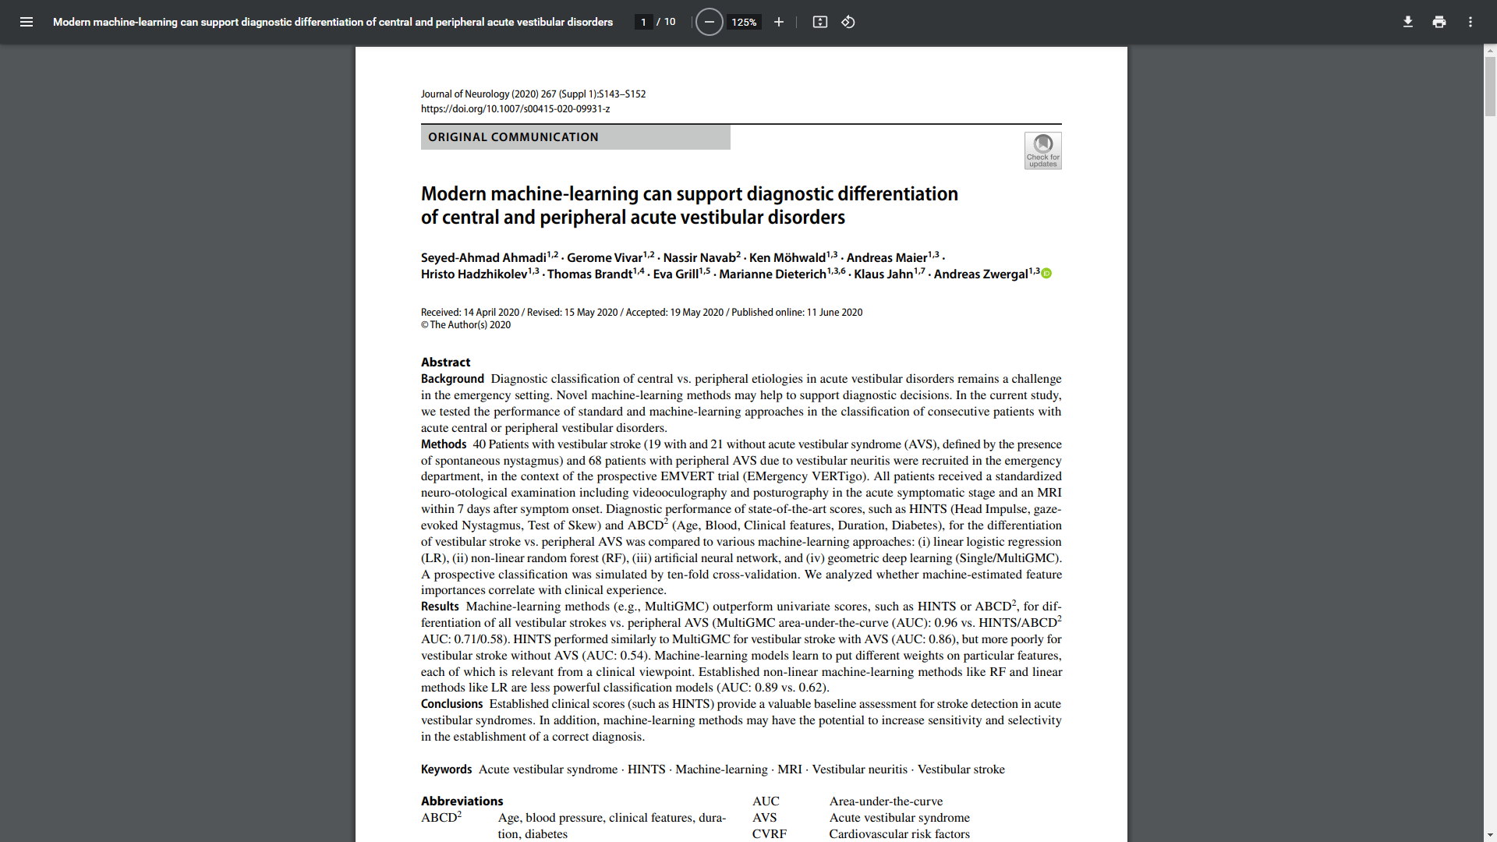
HINTS and Machine Learning
Machine learning can enhance HINTS test
Can machine learning improve upon the HINTS test, univariate analysis, and logistic regression?
Machine learning can improve accuracy, sensitivity, and specificity of clinical exam testing.

Slide 122
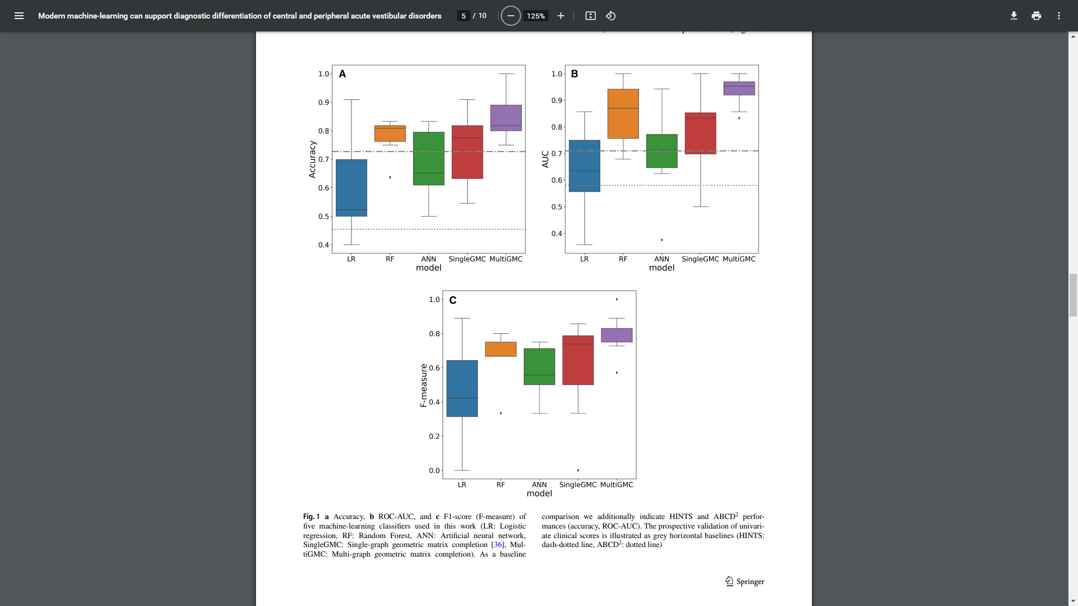
HINTS and Machine Learning
Machine learning (purple) enhances HINTS test
HINTS test utility is the yellow line.
Machine learning is purple box plot.
Machine had greater accuracy (A) and AUC (B) than HINTS alone.

Slide 123
Dizziness / Vertigo Patient Outcome

Slide 124
Dizziness Case: 44 yo Dizzy Male
Sign out. Just check the CT…
44-year-old male, Hx HTN, DM
Six hours continuous dizziness
Unsteadiness. “feeling like I am drunk…”
Normal VS
L beating nystagmus with gaze, L gaze
Improved with ED Rx
“If CT is OK, home with meclizine…”

Slide 125
44 yo Dizzy Male: Is it Central?
Sign out: Just check the CT…
CT is neg, but is the patient clear to go?
Pt with ? decreased auditory acuity L
Mild wide-based gait c/w ataxia
Pt admitted, initial MR DWI negative
Subsequent MR DWI at 72 hours positive for posterior stroke

Slide 126
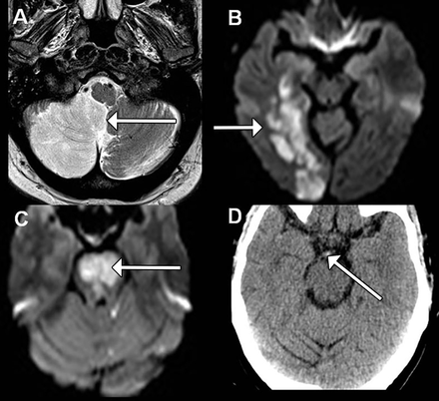
44 yo Dizzy Male: Posterior Stroke
MR demonstrates posterior stroke
Imaging findings associated with the sites of occlusion shown in fig 1. (A) Full right posterior inferior cerebellar artery territory infarct (arrow) shown on T2 weighted magnetic resonance imaging (MRI); (B) acute right posterior cerebral artery territory infarct (arrow) shown on diffusion weighted MRI; (C ) acute bilateral pontine infarction (arrow) as a result of acute basilar occlusion shown on diffusion weighted MRI; (D) axial computed tomography scan showing bright (hyperdense) region (arrow) consistent with an acute basilar thrombus
Right basilar occlusion and posterior stroke findings.

Slide 127
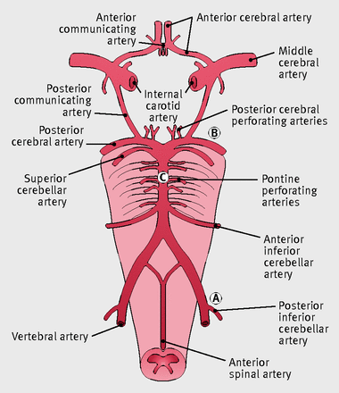
44 yo Dizzy Male: Posterior Stroke
Posterior circulation occlusions.
Anatomy of the vertebral and basilar arterial circulation and circle of Willis.
Site of posterior inferior cerebellar artery occlusion
Site of posterior cerebral artery occlusion
Site of pontine perforating artery occlusion
Arterial occlusions posteriorly.

Slide 128
44 yo Dizzy Male: Is it Central?
Acute vestibular syndrome (AVS)
Vertebrobasilar system posterior stroke?
Posterior circulation tissues
Thalamus
Brainstem (midbrain, pons, medulla)
Occipital lobes
Temporal and parietal lobes
Outcome can be devastating

Slide 129
Posterior Circulation Stroke
Posterior Circle of Willis blood flow disruption to brain and brain stem.

Slide 130
Dizziness / Vertigo EMR Documentation

Slide 131
Dizziness Dot Phrase
Dizziness:
Diagnosis: Non-specific dizziness.
No evidence of syncope or near syncope. No findings c/w vertigo. No motion symptoms noted. No physical exam or test findings demonstrating a systemic cause to the symptoms. Normal CV exam. Neurological exam, including vision, hearing, speech, standing and gait, cerebellar signs, and HINTS testing is normal. Pt not orthostatic. VS normal. EKG and lab testing normal. Able to be discharged safely. Pt aware and agrees with plan for outpatient follow-up. Return prn.

Slide 132
Vertigo Dot Phrase
Vertigo:
Diagnosis: Acute Vestibular Syndrome (AVS)
Patient with motion symptoms c/w vertigo.
Non-specific neurological exam
No evidence of syncope or near syncope. Exam OK.
Normal ENT and CV exam. No vascular abnormalities noted.
Normal neurological exam, including vision, hearing, speech, standing, gait, and cerebellar signs was normal.
Pt not orthostatic. VS normal. EKG and lab testing normal.
HINTS + exam is equivocal. Diagnostic uncertainty.
Admit for further evaluation, including MRI (over time)

Slide 133
HINTS + (+) Dot Phrase
Diagnosis: Acute Vertigo Syndrome (AVS)
Likely Acute vestibular neuritis
HINTS +:
No vertical, torsional, or bilateral fast nystagmus
HIT demonstrates correcting saccade Left, c/w L vestibular system dysfunction
No vertical Skew correction
No facial or extremity weakness
No limb ataxia, dysarthria, speech abnormality, hearing loss*
No pain or temperature sensory loss*
No diplopia, ptosis, anisocoria, dim vision
No truncal ataxia in cart and no ataxic gait
Able to stand and walk without assistance

Slide 134
HINTS + (+) Dot Phrase
Diagnosis: Acute Vertigo Syndrome (AVS)
Likely Acute vestibular neuritis
HINTS +:
Patient well, observed to leave ED without assitance
Able to be discharged safely. Pt aware and agrees with plan for outpatient follow-up. Return as needed.
Dizziness/vertigo medications as indicated.

Slide 135
Is Vertigo Central? EMR Plan
Have neurological exam template
Have a neuro exam for vertigo patients
Template the HINTS + (+) exam
Have dot phrases for decision making
Be able to document functioning (walk…)
Have discharge instructions templated
Know that your documentation will enhance patient outcomes

Slide 136
Dizziness / Vertigo Summary

Slide 137
Dizziness / Vertigo Conclusions
Clear definitions allow for correct diagnoses
Hx leaves dizziness as diagnosis of exclusion
Syncope and systemic causes can be found
3 vertigo types: AVS, s-EVS, or t-EVS
AVS, can be posterior stroke; s-EVS, a TIA
t-EVS, can be possible posterior lesion
Need neuro & HINTS + exams in vertigo pts
Central signs on HINTS + easy to find, document
HINTS + more sensitive than CT, MRI in vertigo

Slide 138
Dizziness / Vertigo Recommendations
Use a reverse Hx with dizziness as Dx of exclusion
Use Hx, Px, VS, labs, EKG, O2 sat for systemic causes
Consider 3 vertigo types: AVS, s-EVS, or t-EVS
With AVS, think posterior stroke; s-EVS, think TIA
With t-EVS, think possible posterior lesion

Slide 139
Dizziness / Vertigo Recommendations
Vertigo? Do both neuro exam and HINTS + exams
Template central signs on neuro, HINTS + exams
Given CT, MRI less useful acutely, use HINTS + first
Be ready for new tech that will assist in central vs peripheral etiology assessments for vertigo patients

Slide 140
HINTS+ (+) is Physical Exam Testing
HINTS+ (+):
Head Impulse (No unilateral saccade bad)
Nystagmus (Bilat fast, vert, rotation bad)
Test of Skew (Vertical skew bad)
+ Hearing loss (New hearing loss bad)
(+) Truncal ataxia and gait (Both bad)
(+) Anterior stroke signs (Any are bad)
If any of these are found: Red Light!

Slide 141
Peripheral Must Haves
Vestibular neuritis or labyrinthitis.
Peripheral etiology.
All Clear. Green light to go home with meds:
Unidirectional horizontal nystagmus only.
One side has a HI saccade (1 vestibular side is ill).
Pupils are aligned vertically on skew test.
No posterior neuro Sxs (hearing loss is HINTS +).
Patient able to sit, stand up, and walk.
Sensory pain & temp testing OK.
No anterior stroke Sx: weak, face, speech, AMS.

Slide 142
Is Vertigo Central? Take Home Ideas
Know the ATTEST system, 3 vertigo types
Know the HINTS + (+) exam
Exclude anterior stroke Sx, Sx
Pt can walk, talk, see, hear, feel, swallow
Observe the patient walking out of the ED
Document using templates
Give specific return Sx in D/C instructions

Slide 143
Educational Objectives
(1) Enhance understanding of the definitions and pathophysiology of dizziness and vertigo.
(2) Understand what diagnoses are likely given the type of vertigo the dizzy patient describes.
(3) Know how to diagnose central causes using the dizzy/vertigo patient physical exam.

Slide 144
Educational Objectives
(4) Specify the exact history and physical exam findings that should be established and documented in the evaluation of ED patients with dizziness and vertigo [ATTEST, HINTS+ (+)].
(5) Review relevant publications that explain the role of the history, physical exam, neuroimaging, and new technologies in patients with dizziness and vertigo.

Slide 145
Edward Sloan, MD, MPH FERNE President and Board Chair. No financial conflicts.
Please go to our ferne.org website and our YouTube channel @ferneorg for more content related to the optimal care of the dizziness and vertigo patient.
Follow us on social media for more real-time information on the care of all patients with neurological illnesses, injuries, and emergencies.

Slide 146
Subscribe: @ferneorg on YouTube Find us on social media: ferne.org@gmail.com Thank you!
EIM 2023 Sloan Dizziness Vertigo Central Dx March 7 2023 Presentation Final Vertical Format

Slide 147
ED Patients with Dizziness and Vertigo: Diagnosing a Serious Central Etiology A Bonus Skiing Tip!
What goes up must come down
Spinnin' wheel got to go 'round
Talkin' 'bout your troubles it's a cryin' sin
Ride a painted pony let the spinnin' wheel spin

Slide 148
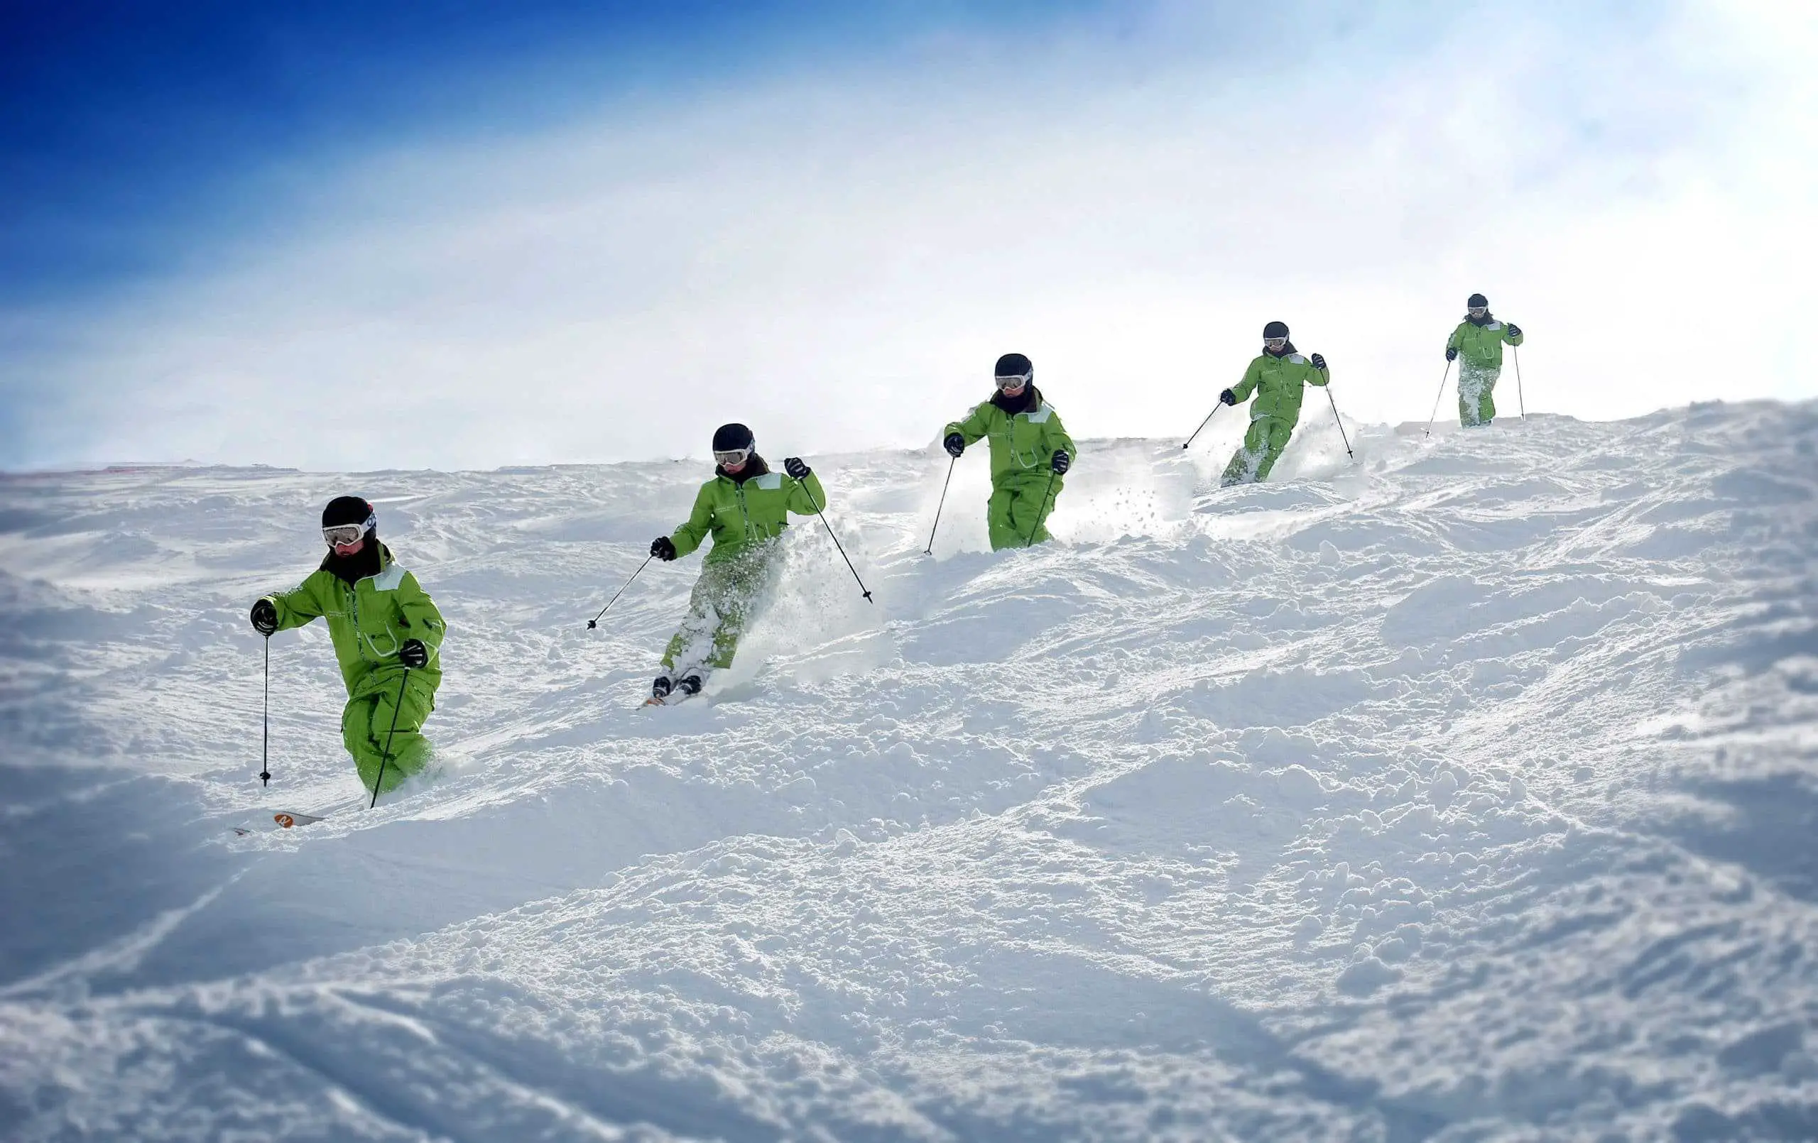
Where / how to turn?
Skiing Tip:
Turn around your pole plant, 3-4 feet above the snow pile. (black dots)
Turns start above the soft pile. (blue/purple)
Your skis (red) then are across the fall line in the soft piles (orange).

